Slide 1

#LifeKoKaroLift
PG Diploma in ML/AI

Slide 2



Course : Machine Learning
Lecture On : Text cleaning in NLP
Instructor : Siddhesh Gunjal

Slide 3
Today’s Agenda
1
Text cleaning
2
Tokenization
3
Stop-word removal
4
Lemmatization
5
Word Cloud Analysis

Slide 4
Text cleaning
Text cleaning is task-specific and one needs to have a strong idea about what they want their end result to be and even review the data to see what exactly they can achieve.
Take a couple of minutes and explore the data. What do you notice at a first glance?

Slide 5
Text cleaning
Having too many typos or spelling mistakes in the text
Having too many numbers and punctuations (E.g. Love!!!!)
Web links in the text
Text is full of emojis and emoticons and username and links too. (If the text is from Twitter or Facebook)
Some of the text parts are not in the English language. Data is having a mixture of more than one language
Some of the words are combined with the hyphen or data having contractions words. (E.g. text-processing)
Repetitions of words (E.g. Data)

Slide 6
Methods to clean the text corpus
Lowercasing the data
Removing Punctuations
Removing Numbers
Removing extra space
Replacing the repetitions of punctations
Removing Emojis
Removing emoticons
Removing Contractions

Slide 7
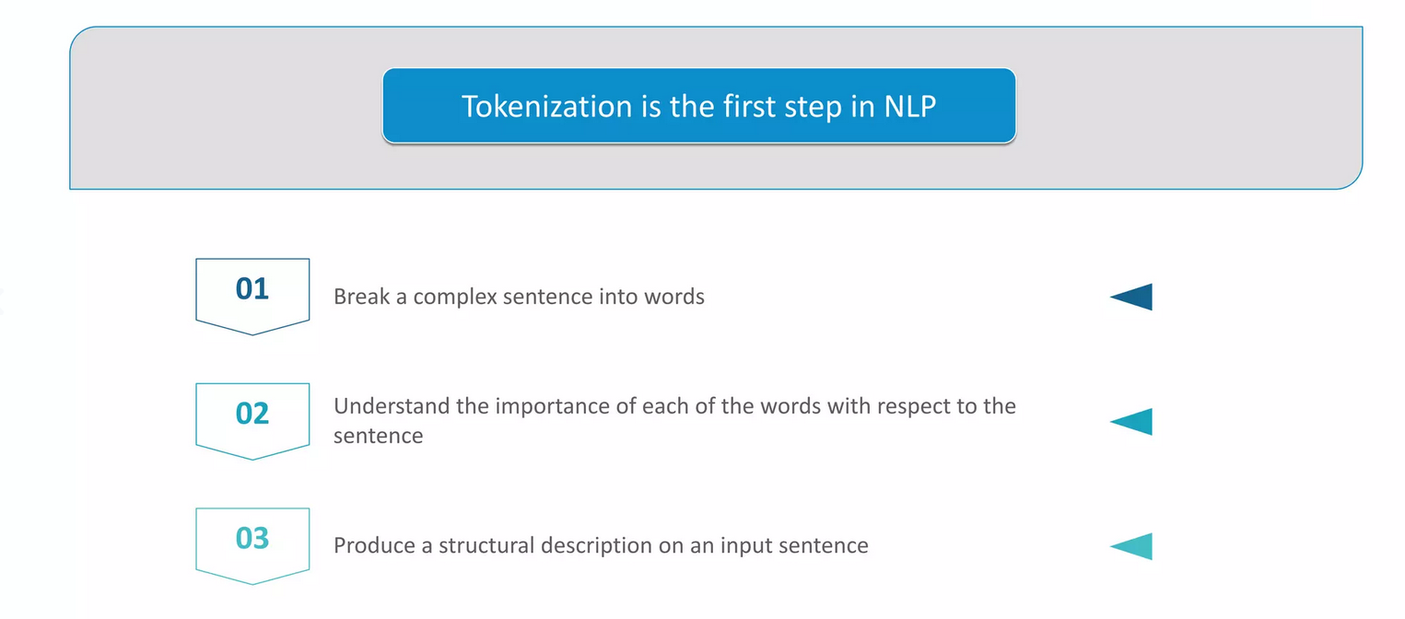
Tokenization

Slide 8
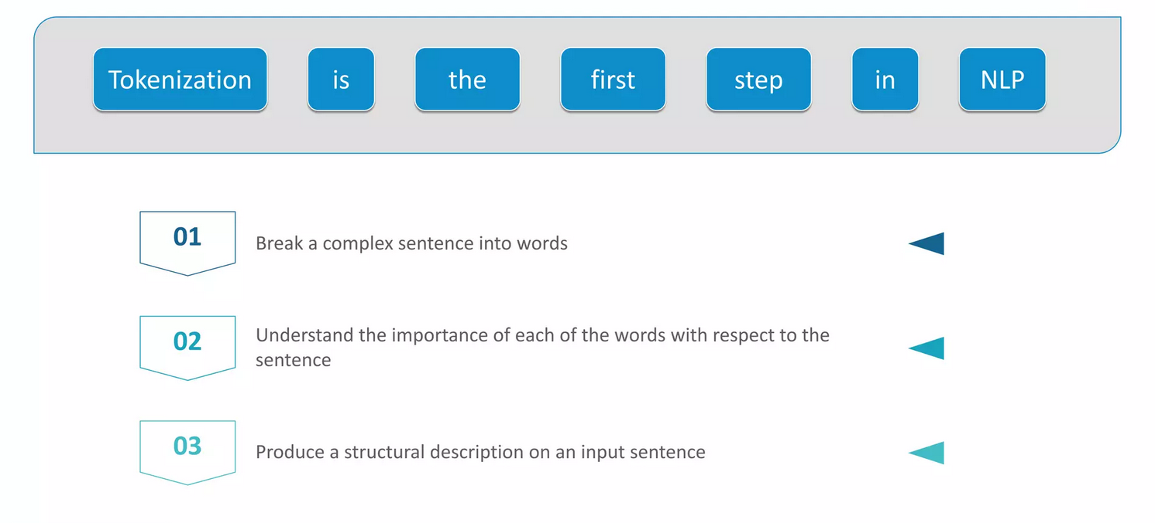
Tokenization

Slide 9
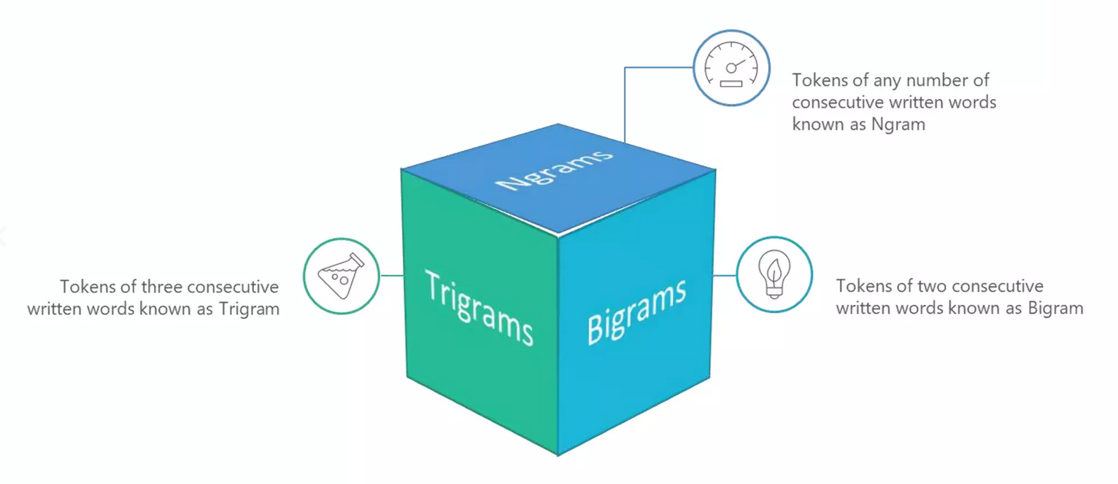
Tokenization

Slide 10
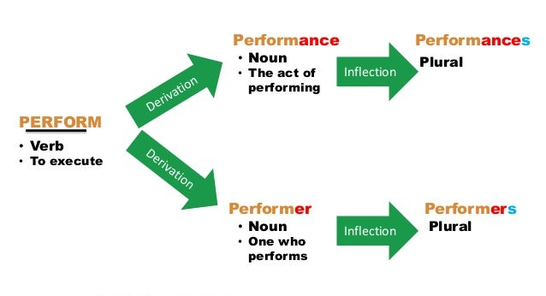
What is Word Inflection

Slide 11
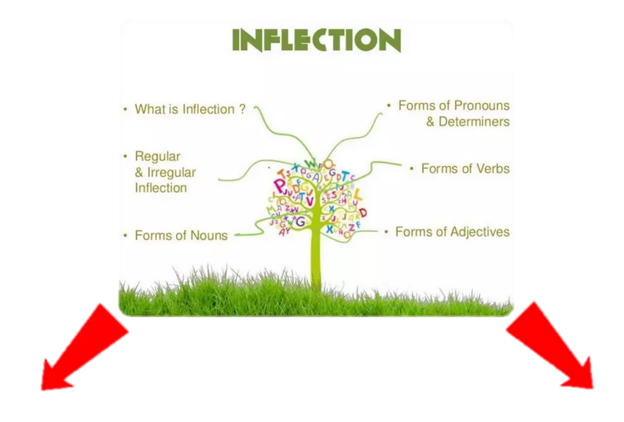
What is Word Inflection
Stemming
Lemmatization

Slide 12
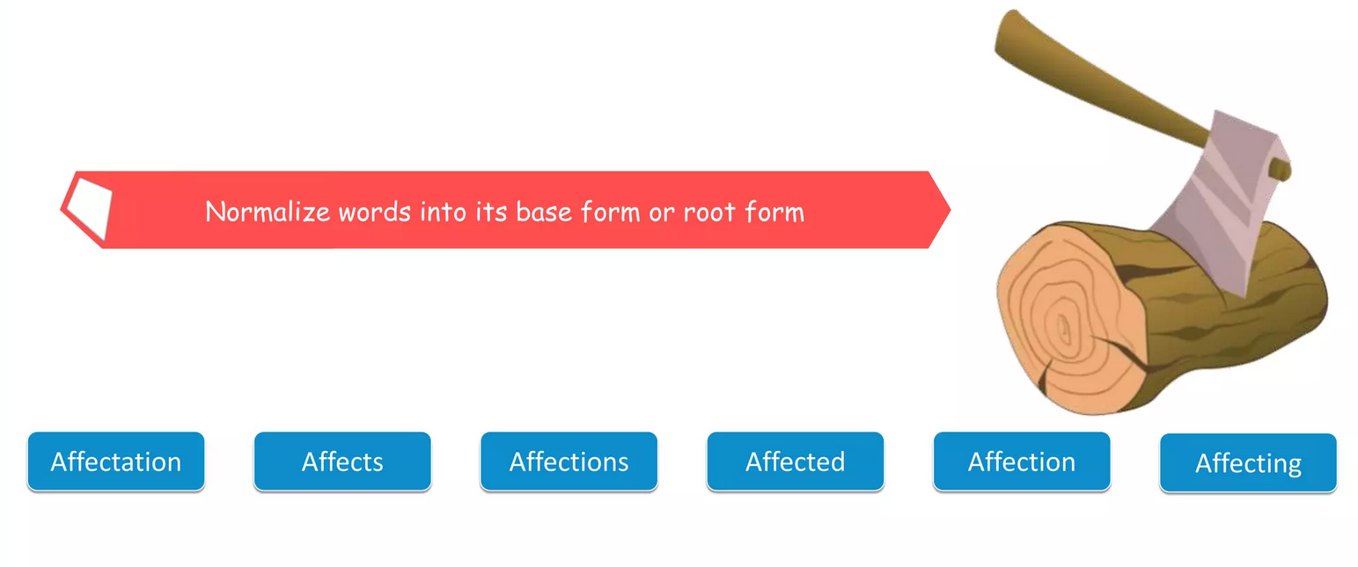
Stemming

Slide 13
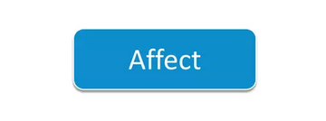
Stemming

Slide 14
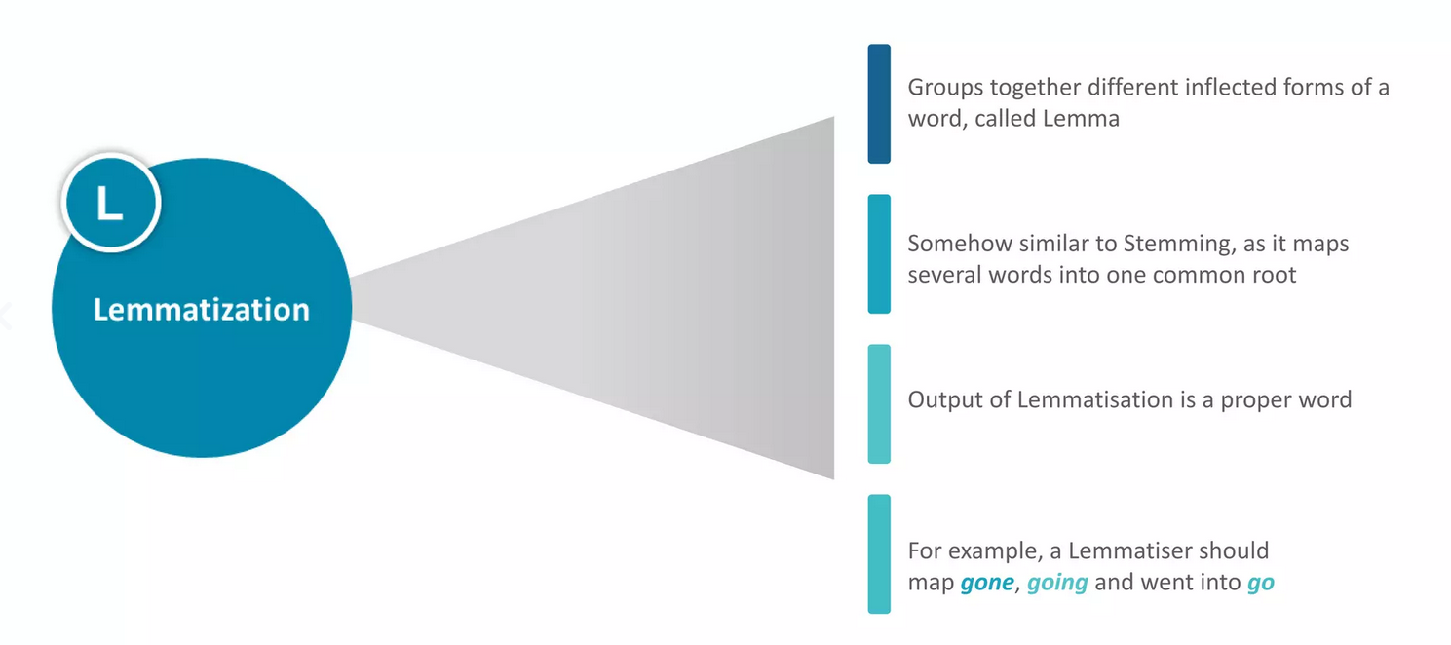
Lemmatization

Slide 15


Stemming Lemmatization
Might not be an Actual Language word
Predefine Steps
Actual Language word
User WordNet Corpus

Slide 16
Let play with our results now

Slide 17
Thank You !

